Slide 1
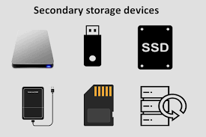
Secondary Storage
A storage medium that holds information until it is deleted or overwritten.
This section of storage is also referred to as backup storage.
The storage capacity of primary storage is not sufficient to store the large volume so secondary storage.
The secondary memory is accessed indirectly via input/output operations.
This memory is also called backup storage or mass storage media.

Slide 2
Distinguishing Characteristics of Secondary Storage
As we examine some secondary storage media, look out for the following:
Capacity
Access Method
Access Speed
Portability

Slide 3
Types of Secondary Memory
Secondary memory is of two types:
Fixed Storage
Removable Storage

Slide 4
Fixed Storage
A fixed storage is an internal media device that is used to store data in a computer system.
Generally, the data of the computer system is stored in a built-in fixed storage device.
Following are Fixed Storage devices:
Internal Flash Memory
Hard Disk Drives (HDD)
SSD (Solid-State Disk)

Slide 5
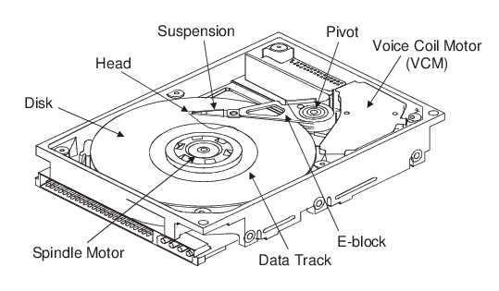
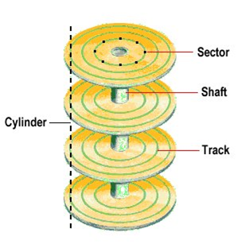
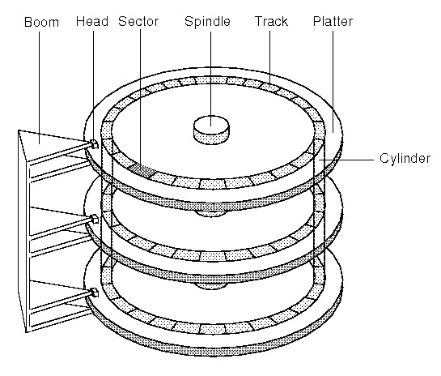
Hard Disk Drives (HDD)
Hard Disk was introduced and patented in the year 1956 in IBM’s San Jose, California laboratory.
It is a rigid magnetic disc that is used to store data.
It is located within the drive unit.
Hard disks or hard disk drives come in different storage capacities(like 256 GB, 500 GB, 1 TB, and 2 TB, etc.).

Slide 6
Advantages
Disadvantages
One of the significant advantages of a Hard Disk drive is that its cost is low.
Another advantage of a Hard Disk is that it is readily available in the market.
Hard Disk is faster than optical disks.
The capacity for storing the data in HDDs is large.
The speed of reading and writing in HDD is slower than the RAM.
HDDs are noisy.
Another disadvantage of HDD is energy inefficiency.
HDDs consume more power.
The form factor of HDDs is heavier than the SSDs.

Slide 7
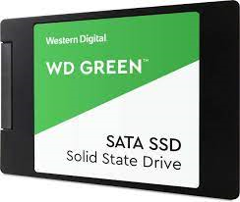
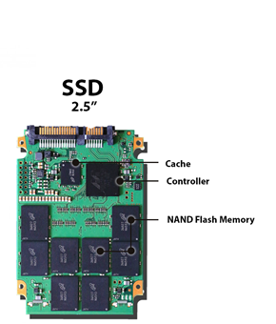
Solid-State Drive: (SDD)
SSD (Solid State Drive) is also a non-volatile storage medium that is used to hold and access data.
Solid-state drive (SSD) is a solid-state storage device that uses integrated circuit assemblies as memory to store data.
It is more expensive.
These storage devices store the data in the semiconductor cells.

Slide 8
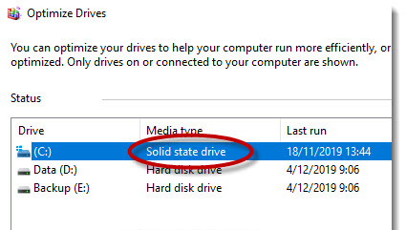
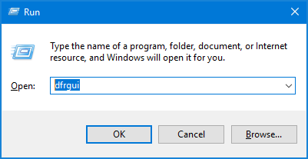
Questions
Que. How do we know we have both SSD and HDD in our laptops?
Que. Can we use both SSD and HDD?

Slide 9
Removable Storage
In secondary memory, removable storage is an external media device that is used to store data in a computer system.
It is a storage device that can be inserted or removed from the computer according to our requirements.
Following are Removable Storage devices:
Floppy disks
Magnetic tapes
Disk packs
Memory cards
Optical discs (like CDs, DVDs, Blu-ray discs, etc.)

